Slide 1
CAPSTONE PROJECT
BATTLE OF NEIGHBORHOODS
-SUBHADEEP DEB

Slide 2
INTRODUCTION
Toronto, the capital of Ontario province is the most populous city in Canada and the 4th most in entire North America with a population of 2.9 million in 2017. Toronto is an international center of business, finance, arts, and culture, and is recognized as one of the most multicultural and cosmopolitan cities in the world, attracting tourists as well as immigrants from various different parts of the world. Of the 2011 population, a whopping 49% of people living in Toronto are immigrants (higher than the Canada-wide 29%) of which the Indian community accounts for 6.3% of the total population. Having a considerable amount of Indian population in Toronto means a good chunk of people will be practicing Indian culture and customs in Toronto and the ethic food is undoubtedly one of the biggest part of Indian lives. Research paper published by Joel Waldfogel found that Indian cuisine was the 4th most popular in the world hence all these factors indicate no shortage in demand of Indian restaurants in Toronto.
PROBLEM STATEMENT- To find the best place in Toronto to open a new Indian Restaurant.

Slide 3
DATA
For this project we used the following data:
1) Wikipedia page 'https://en.wikipedia.org/wiki/List_of_postal_codes_of_Canada:_M' to get data containing the postal codes of various regions of Canada.
2) Foursquare API: to get the information about different venues (Indian Restaurants) in Toronto.
3) Beautiful Soap for web page scraping.
4) "https://cocl.us/Geospatial_data": We will get the data of Toronto from here

Slide 4
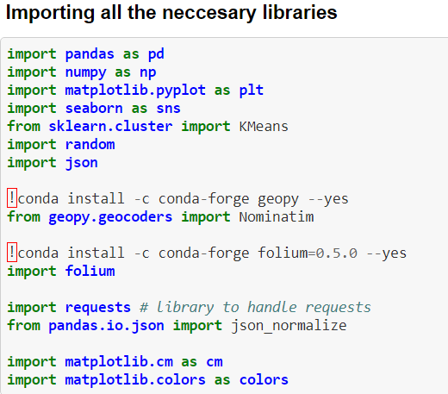
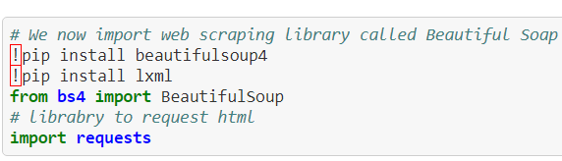
METHODOLOGY
Importing Libraries, Web Scraping and Data Cleaning
At first, we imported all the necessary libraries

Slide 5
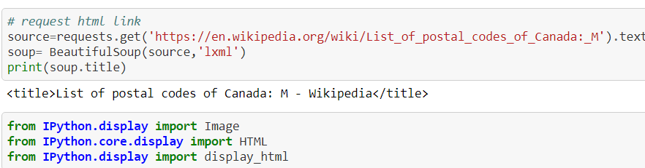
We then used web scraping to get data of postal codes of various Boroughs of Canada from the Wikipedia page 'https://en.wikipedia.org/wiki/List_of_postal_codes_of_Canada:_M', we store the information in a new dataset containing names of boroughs, neighbourhoods and postal codes.
Now we see that the dataset contains various ‘Not assigned’ values hence we need to clean the data set by dropping the postal codes having ‘Not Assigned’ values and storing the values in a new dataframe.

Slide 6
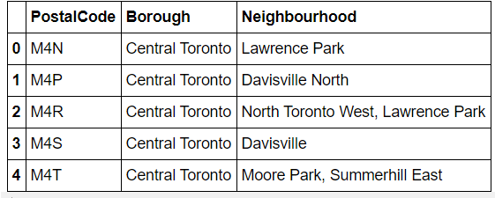
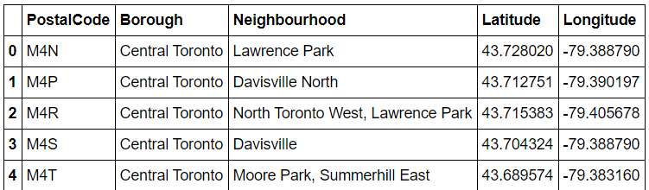
Now create a new table containing the co-ordinates of all the postal codes with help of "https://cocl.us/Geospatial_data" and then merge this table with the table containing names of boroughs and neighbourhoods. We now only look for those neighbourhoods that have word ‘Toronto’ in it as our focus is only on the city of Toronto.

Slide 7
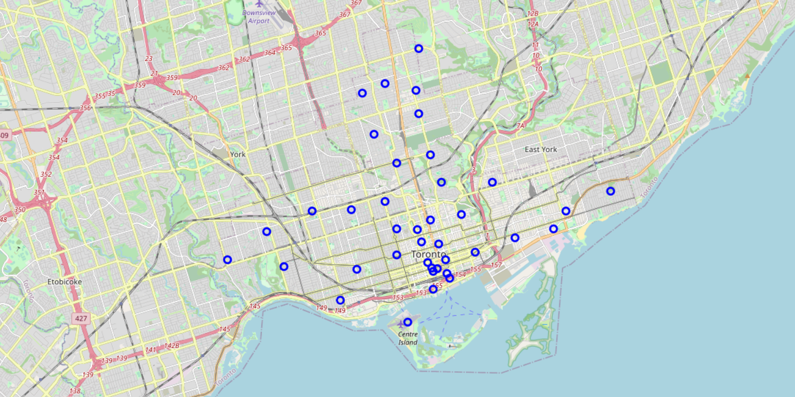
Visualization
We now visualize all the neighbourhoods of Toronto with help of folium map and create popup label showing the neighbourhood’s name.

Slide 8
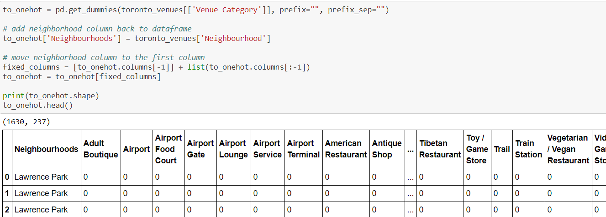
Then with the help of Foursquare API we create a get request URL to get the top 100 venues within a radius of 500 meters. Then we do one hot encoding for getting dummies of the venue category and group the whole data by Neighbourhoods.
Machine Learning
We will use k-means clustering to create separate clusters containing different neighbourhoods of Toronto. But for using k-means clustering we must first find the optimal value for k so we create a graph containing different values of k and the corresponding error. By analysing the graph, we see that the elbow point for the graph occurs at k=4, hence we choose k=4. choose k=4.

Slide 9
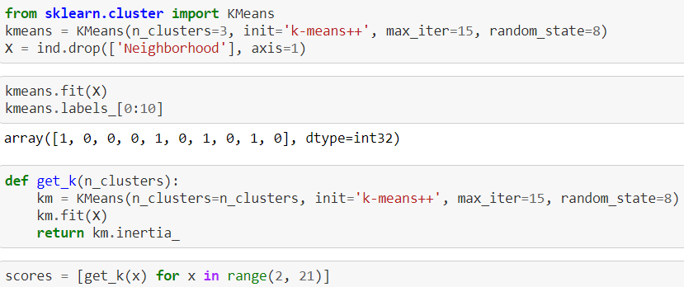
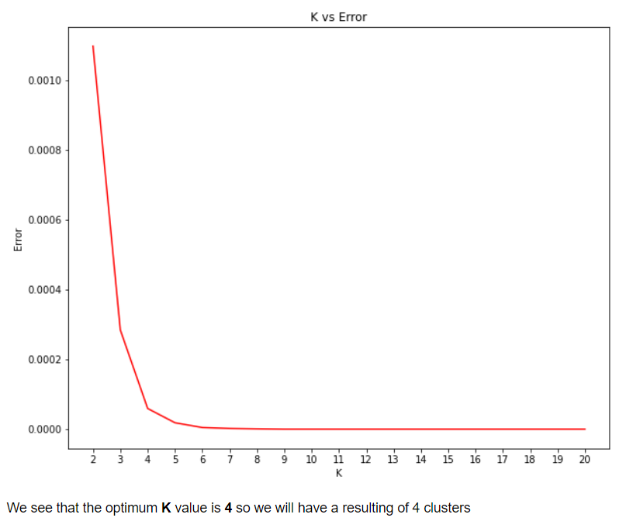

Slide 10
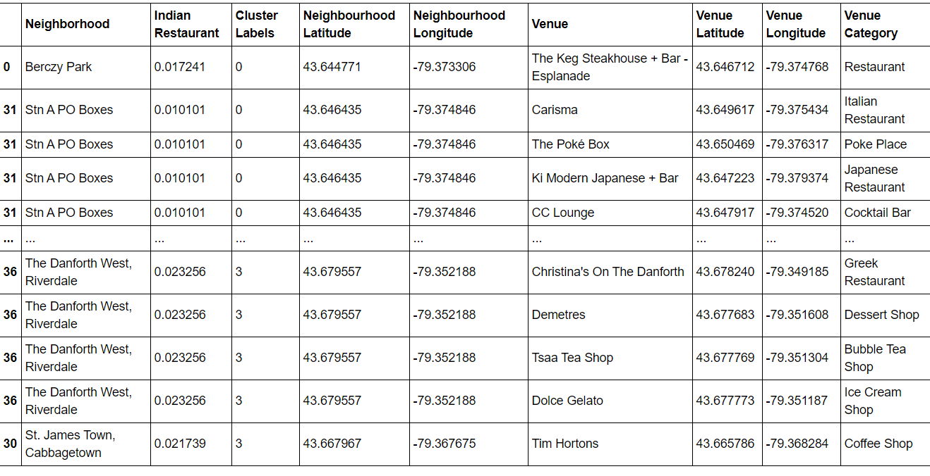
So now we cluster the neighbourhoods and merge the tables so that we can see the names of neighbourhood, cluster, co-ordinates, venue categories.

Slide 11
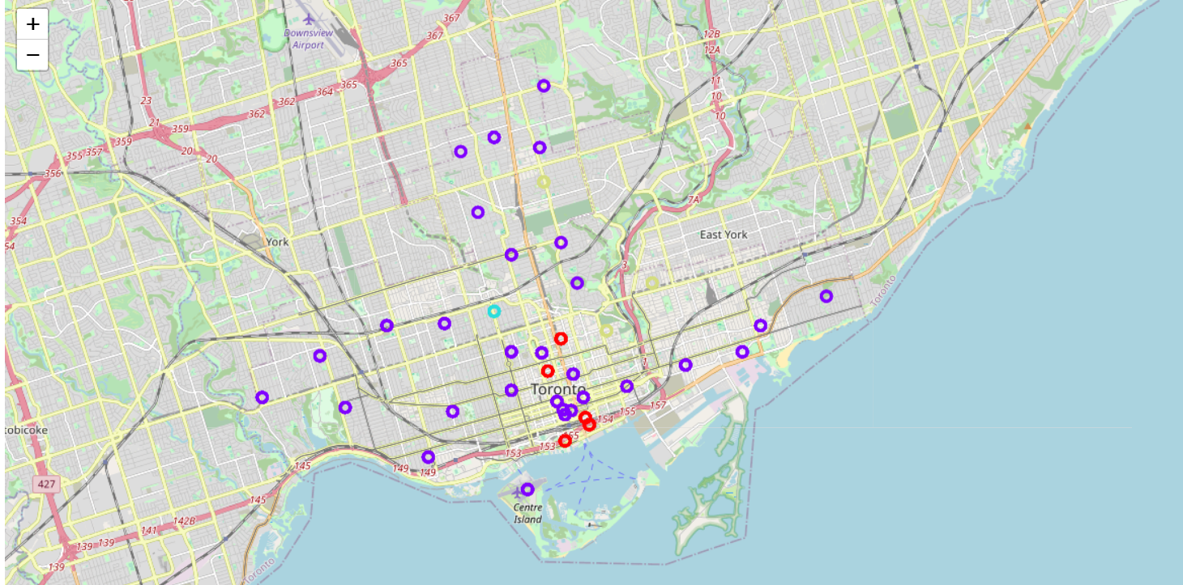
Now we show all the clusters in a Toronto map with help of folium to better visualise the results.

Slide 12
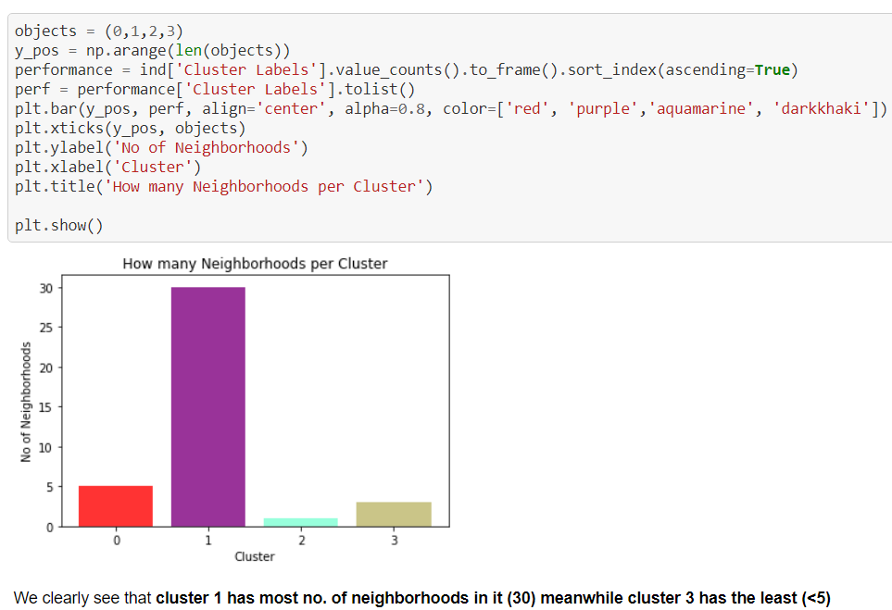
RESULTS
We find out the number of neighbourhoods in each cluster to give us the idea of each cluster. We find out that Cluster 1 has the greatest number of neighbourhoods (30) followed by Cluster 0, Cluster 3 and Cluster 2.

Slide 13
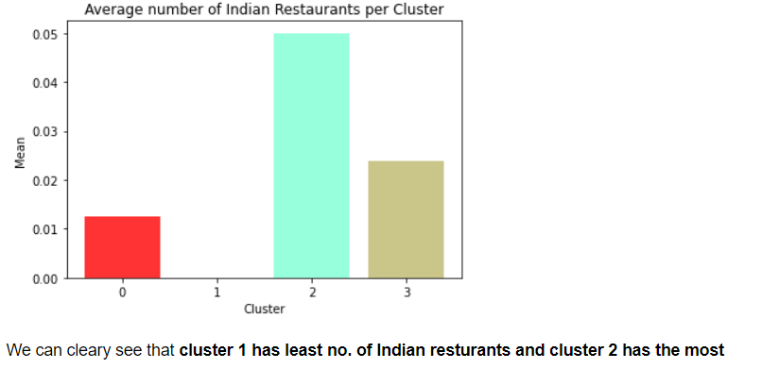
Then we look at the number of Indian restaurants in each of these clusters and find that Cluster 2 has the highest number of Indian restaurants followed by Cluster 3 and Cluster 0 meanwhile Cluster 1 has little to no Indian restaurants.
Then we find the neighbourhoods in Cluster 2.

Slide 14
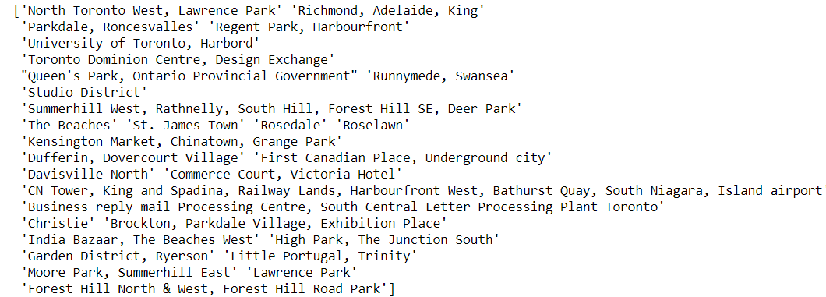
DISCUSSION
As we can see that the Cluster 1 has the most no. of Neighbourhoods but has the least number of Indian restaurants of any cluster of Toronto. This shows that there is a potential market for opening a new Indian restaurant in Cluster 1 neighbourhoods like Richmond, Studio District, Rosedale etc. Meanwhile the situation is quite the opposite on Cluster 2 which as the fewest no. of neighbourhoods but the most no. of Indian Restaurants. Cluster 0 and Cluster 3 both have average no. of neighbourhoods and average no. of Indian restaurants hence they are well balanced. In the end I will conclude that if I had to open a new Indian Restaurant in Toronto, I would have opened it in Cluster 1 neighbourhood.

Slide 15
CONCLUSION
With this report we found out a potential region for opening a new Indian restaurant in Toronto with the help of various data science tools. The results of the report can be improved with more comprehensive analysis and with help of other better data sources in the future.

